Slide 1
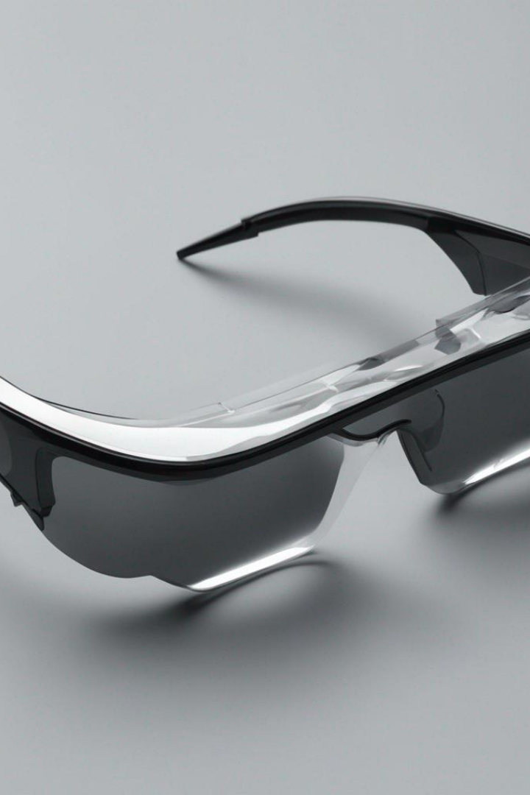
Smart Glasses
Shivam Awasare
T1411004
S

Slide 2
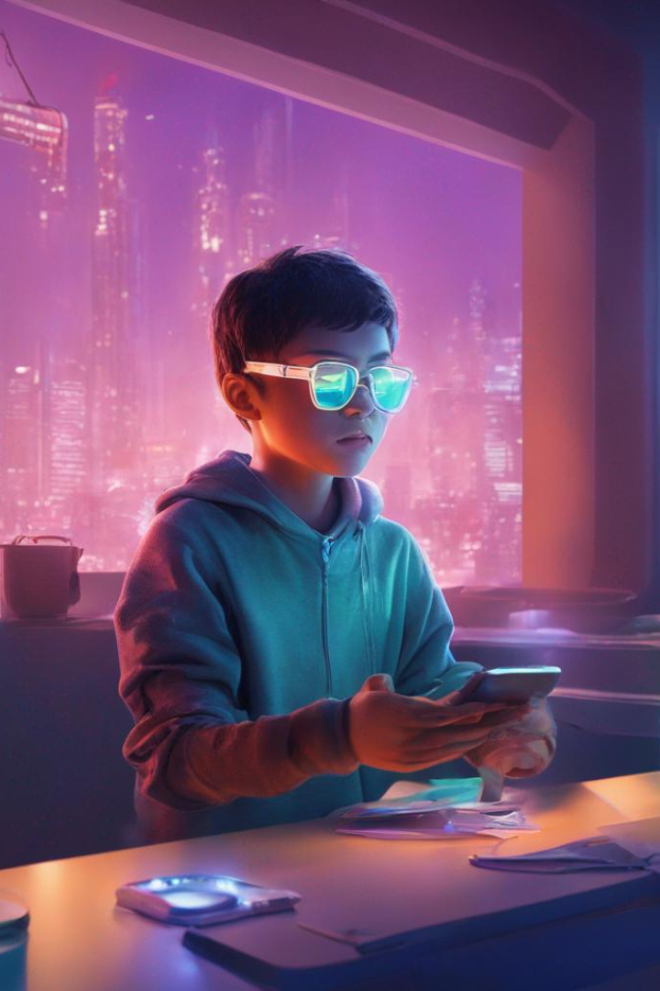
Abstract
Smart glasses use a combination of algorithms for sensor data processing, computer vision, SLAM, and augmented reality rendering to merge digital content with the real world. Gesture and voice recognition algorithms facilitate user interaction, while wireless communication protocols enable connectivity. Efficient power management algorithms optimize battery usage.
Keywords: Smart glasses, Augmented reality, Algorithms, Sensor data processing, Computer vision, SLAM, Gesture recognition, Voice recognition, Wireless communication, Power management.

Slide 3
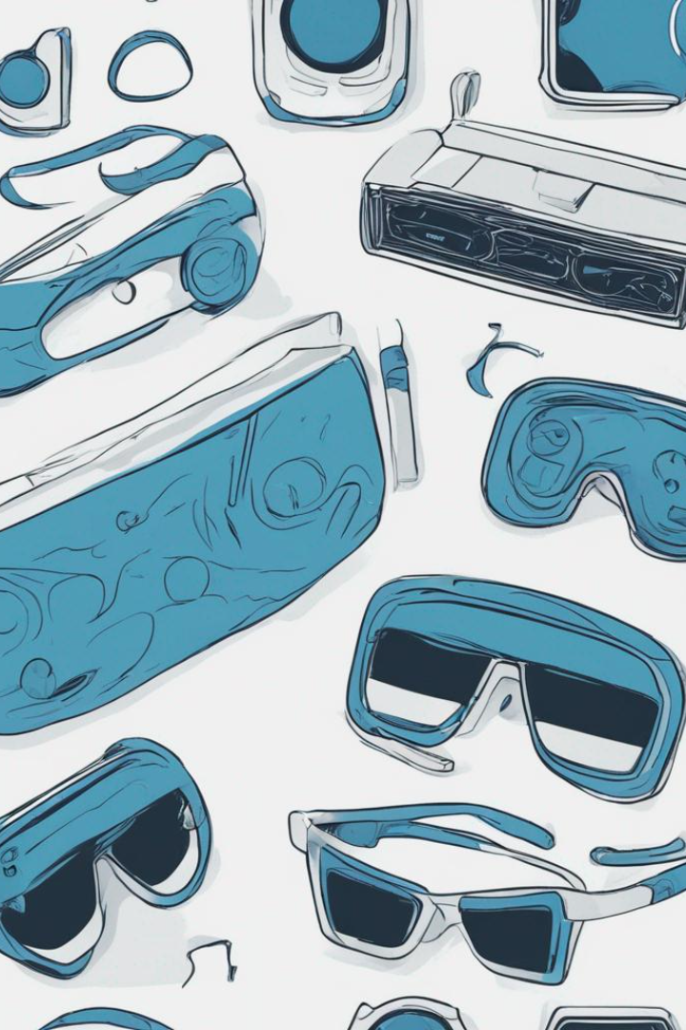
Agenda/Introduction
Welcome to our presentation on Smart Glasses! In this session, we will cover the following topics:
Definition and Evolution: We will start by exploring what smart glasses are and how they have evolved over time.
Literature Review: Next, we will review the latest research and insights from experts in the field of smart glasses.
Real-World Applications and Use Cases: We will discuss various practical applications and use cases of smart glasses in industries such as healthcare, manufacturing, and education.
Future Scope: We will examine the potential future developments and advancements in smart glasses technology.
Algorithm Used: We will talk about all the algorithms used in smartglasses.
Working: We will discuss working procedures.

Slide 4
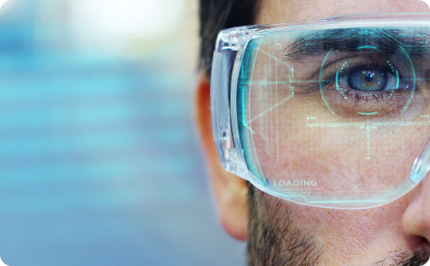

Problem Statement & Objective
Problem Statement:
Objective:
Developing an efficient real-time augmented reality system for smart glasses that seamlessly overlays digital information onto the user's field of vision, allowing for natural interaction.
To design and implement algorithms and hardware components that enable accurate environmental sensing, augmented reality rendering, user-friendly gestures and voice interaction, and optimized power management in smart glasses.

Slide 5
Definition and Evolution
What are Smart Glasses?
A Brief History
Current Innovations
Explore the evolution of smart glasses, from the early prototypes to the cutting-edge technologies that are reshaping our daily lives.
Discover the latest advancements in smart eyewear, including sleek designs, enhanced functionalities, and seamless integration with other devices.
Smart glasses are wearable devices that combine advanced technology with eyewear, providing users with a heads-up display and various interactive functionalities.

Slide 6
Literature Review 1
Paper Name
Author
Publication
Methodology
Applications of Smart Glasses in Applied Sciences: A Systematic Review
Dawon Kim and Yosoon Choi
MDPI
The study employed a systematic review methodology, analyzing 82 academic papers published between January 2014 and October 2020. Out of these, 57 papers were selected through filtering, and four research questions were formulated to investigate smart glasses applications and trends.

Slide 7
Literature Review 2
Paper Name
Author
Publication
Methodology
Augmented reality smart glasses: an investigation of technology acceptance drivers
Philipp A. Rauschnabel and Young K. Ro
Inderscience
The study proposes an adoption model for Augmented Reality Smart Glasses based on prior technology acceptance research. It conducts an empirical study to assess factors influencing adoption, including functional benefits, ease of use, individual differences, brand attitudes, and social norms. The impact of self-presentation benefits and privacy concerns on adoption is also examined.

Slide 8
Literature Review 3
Paper Name
Author
Publication
Methodology
Augmented Reality “Smart Glasses” in the Workplace: Industry Perspectives and Challenges for Worker Safety and Health
Sunwook Kim, Maury A. & Joseph L. Gabbard
Google Scholar
The study conducted interviews with industry experts across different sectors to investigate the potential of smart glasses and augmented reality head-worn display (AR HWD) technologies in the workplace. It focused on identifying opportunities and practical concerns related to interface design, distractions, workplace safety, and health implications.

Slide 9
Algorithms in Smart Glasses
Sensors and Cameras:
Data Processing:
AR Overlays:
Display:
Augmented Reality Rendering
Display Control Algorithms
Sensor Data Processing
SLAM (Simultaneous Localization and Mapping)
Image Processing
Computer Vision
Interactivity:
Wireless Connectivity:
Battery Power:
Gesture Recognition
Power Management
Voice Recognition (NLP)
Wireless Communication Protocols

Slide 10

Working of Smart Glasses
Sensors and Cameras: Smart glasses have built-in sensors (e.g., accelerometers, gyroscopes) and cameras to capture the wearer's surroundings.
Data Processing: Data from sensors and cameras are processed to understand the wearer's environment and movements.
AR Overlays: Augmented reality content, such as information, graphics, or 3D objects, is generated and overlaid onto the real-world view displayed on the glasses' screens.

Slide 11
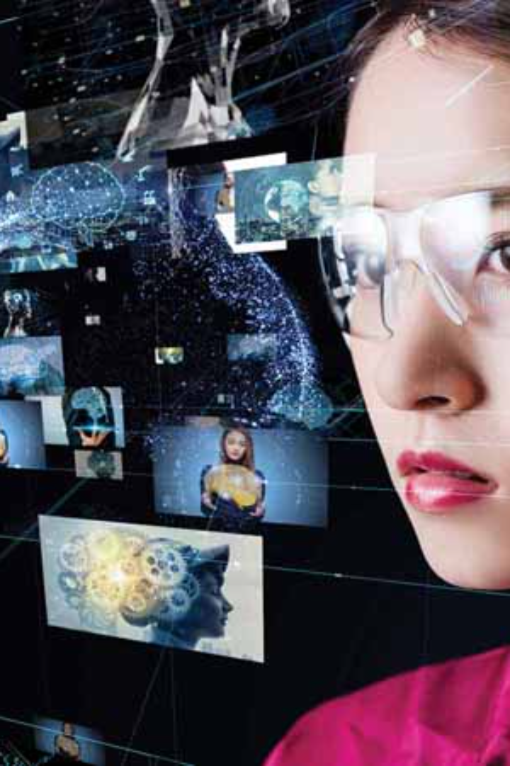
Working of Smart Glasses
Display: The AR content is presented on the transparent screens in the wearer's field of vision, allowing them to see both the real world and digital information.
Interactivity: Users can interact with the AR content through gestures, voice commands, or eye movements.
Wireless Connectivity: Smart glasses can connect to the internet and other devices (e.g., smartphones) to access data and services.
Battery Power: Efficient power management ensures that the glasses run on battery power for extended periods.

Slide 12
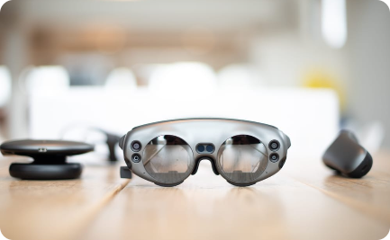
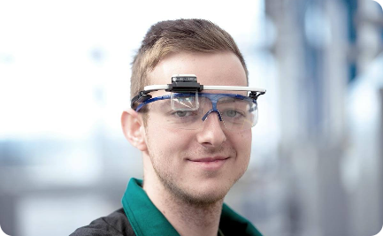
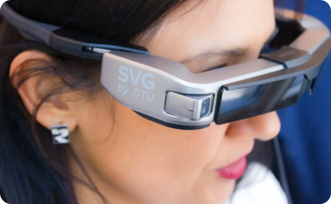
Applications and Use Cases
Augmented Reality Experiences
Hands-Free Communication and Messaging
Assistance for Visually Impaired Individuals
Embark on a virtual journey, where smart glasses transport you to immersive digital landscapes, blurring the line between reality and fiction.
Witness the empowering impact of smart glasses, offering real-time object recognition and navigation assistance for visually impaired individuals.
Experience the seamless integration of smart glasses with communication apps, enabling effortless and intuitive hands-free conversations.

Slide 13

Conclusion
1
The Future Beckons
2
User-Centric Innovation
3
Limitless Possibilities
Reflect on the transformative potential of smart glasses and envision a future where technology seamlessly integrates into our daily lives.
Highlight the importance of designing smart glasses with a user-centric approach, prioritizing comfort, accessibility, and meaningful functionalities.
Encourage exploration and experimentation, as smart glasses unlock endless possibilities for communication, productivity, and self-expression.

Slide 14
Future Scope
Medical Advancements
Enterprise Solutions
Entertainment and Gaming
Imagine a future where smart glasses help healthcare professionals enhance diagnostics, monitor patients, and revolutionize the field of medicine.
Explore the potential of smart glasses in the workplace, empowering employees with real-time information, remote collaboration, and hands-free workflows.
Delve into the immersive world of smart glasses gaming, where virtual worlds come to life, transforming how we play and engage with digital entertainment.

Slide 15
References
[1] https://www.mdpi.com/2076-3417/11/11/4956
[2] https://ieeexplore.ieee.org/abstract/document/8368051/
[3] https://www.sciencedirect.com/science/article/pii/S2452414X20300509
[4] https://ieeexplore.ieee.org/abstract/document/7927376/
[5] https://content.iospress.com/articles/technology-and-health-care/thc910
[6] https://www.sciencedirect.com/science/article/pii/S2666520423000346

